Slide 1

StyleGen
Image Style Transfer Using VGG-19
Deepak V
S4 MCA
17

Slide 2
Contents
Abstract
Module Description
Existing System vs Proposed System
Technologies Used
Proposed System Design
Architecture Design
ScreenShots
Conclusion
Future Enhancement

Slide 3
Abstract
Image style transfer is a deep learning technique for blending the content of one image with the style of another.
The output is a new image with the same content as the original content image, but with the style of the style image.
This can be achieved by using neural networks to separate and recombine the content and style features of the images.
This new method has high computational efficiency and a good style transfer effect. Pre-trained VGG-19 (Visual Geometry Group) neural network models are used to achieve image style transfer.

Slide 4
Module Description
Image Loading & Pre processing
This module will load the content and style images, pre-process them to prepare them for input into the VGG-19 network, and convert them to tensor format.
.
05
Loss calculation module
This module will calculate the total loss for the image style transfer. The total loss will be composed of a content loss term and a style loss term, both of which will be computed using the features extracted by the VGG-19 network.
01
04
Optimization module
This module will use an optimization algorithm (such as gradient descent) to minimize the total loss and generate the stylized output image.
VGG-19 feature extraction module
This module will use the VGG-19 network to extract features from both the content and style images.
02
03
Post Processing module
This module will perform any necessary postprocessing on the output image, such as converting it back to image format and rescaling it to the original size. It may also display the output image or save it to disk. And Draw the Total Loss graph

Slide 5
Existing System vs Proposed System
Sl No | Existing System | Proposed System
1 | Only Prototype models are available. | This system is not like a prototype model. It's a standalone application.
2 | Since Its a prototype model lack of good GUI. | This system having good and simplistic GUI using tkinter package in python.
3 | Since, Its prototype all input parameters are fixed. | This system takes advantage for adding our own input parameters like an application.
4 | There is no available for checking the performance of the model. | Total loss graph analysis is available to check the performance of model.

Slide 6




Technology Used
IDE’s | Platforms | Tools

Slide 7
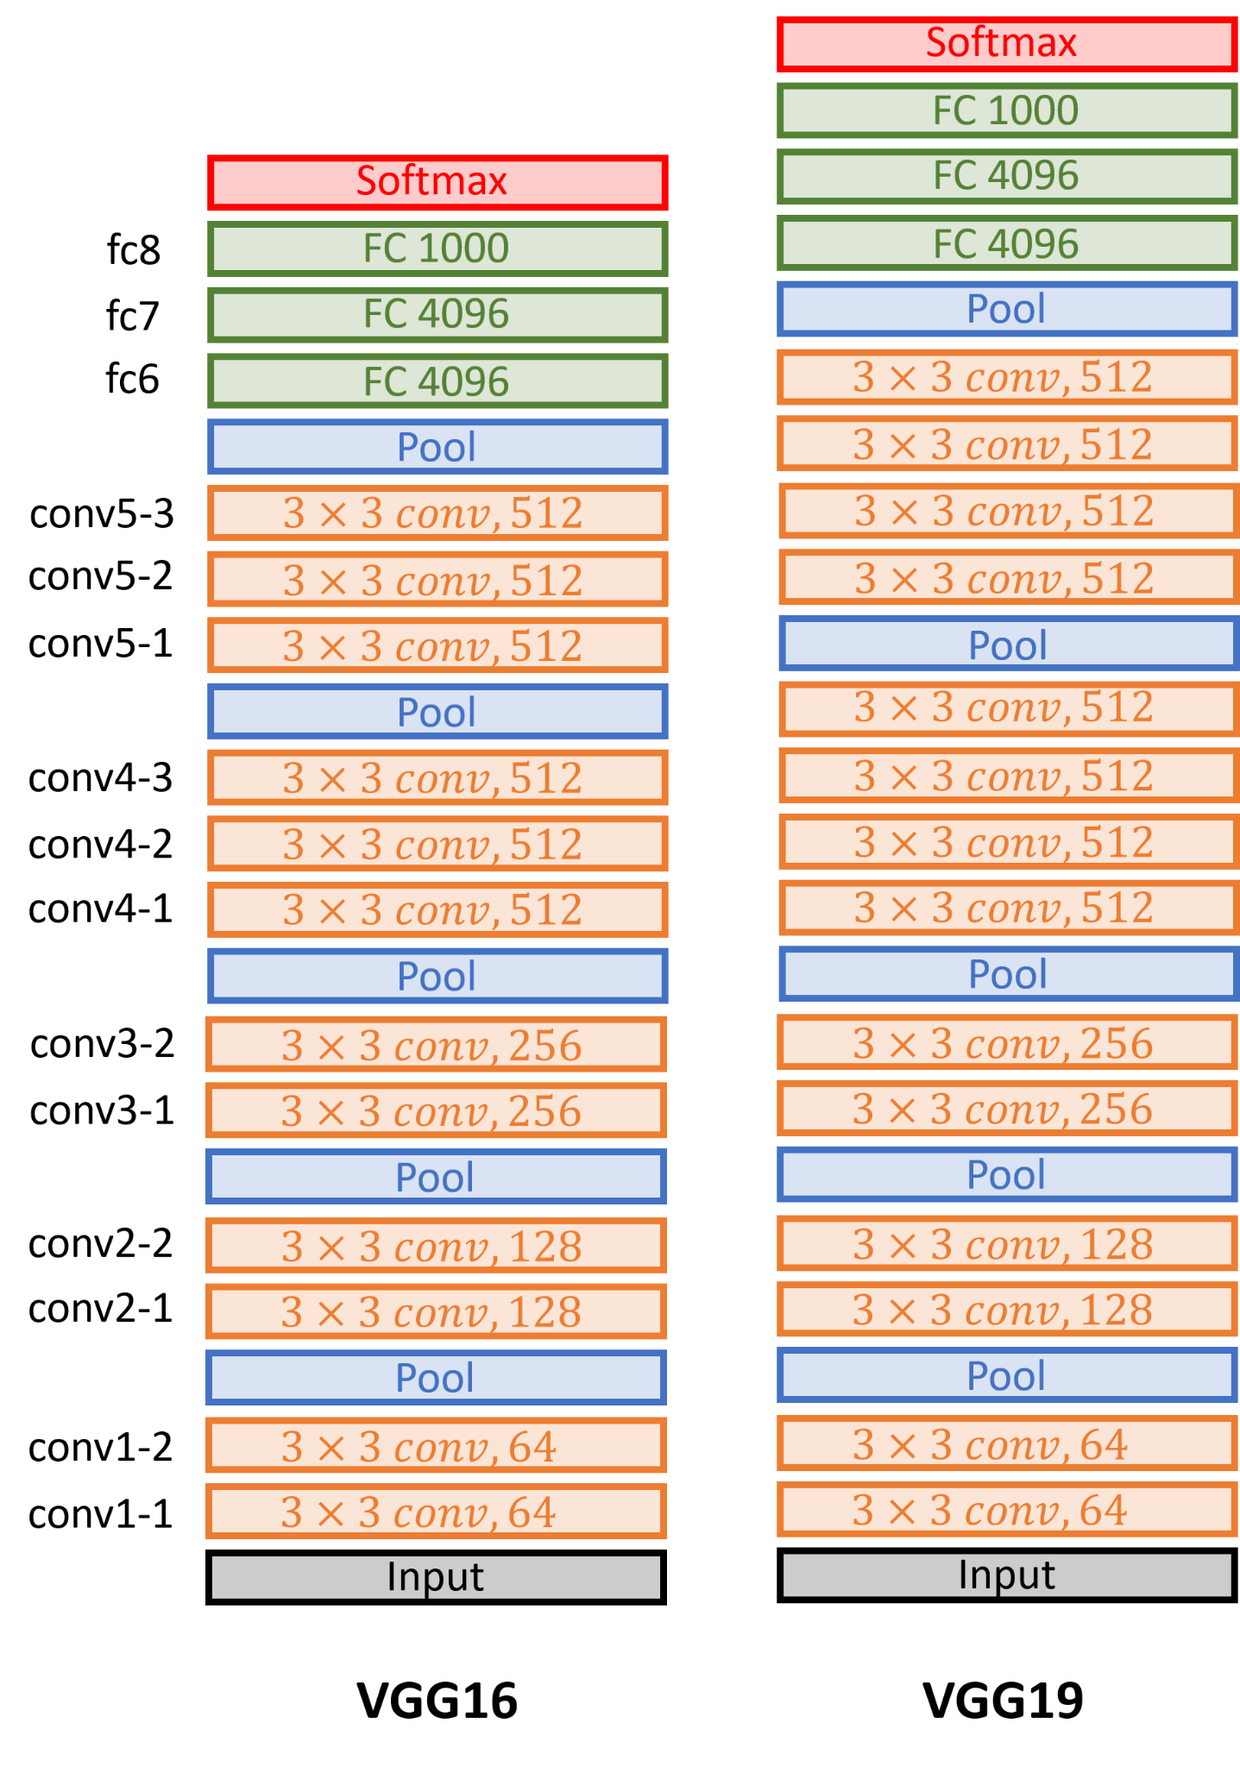
VGG-19
VGG-19 is a deep convolutional neural network developed by the Visual Geometry Group at the University of Oxford.
It has 19 layers of trainable parameters, including 16 convolutional layers, 3 fully connected layers, and 5 max-pooling layers.
VGG-19 has 3 additional convolutional layers compared to VGG-16, allowing it to capture more complex features in images.
VGG-19 has exceptional performance in image recognition tasks and has achieved top performance in several challenges, including the ImageNet Large Scale Visual Recognition Challenge in 2014.
VGG-19 has strong transfer learning capabilities and can be fine-tuned on smaller datasets for specific image recognition tasks.

Slide 8
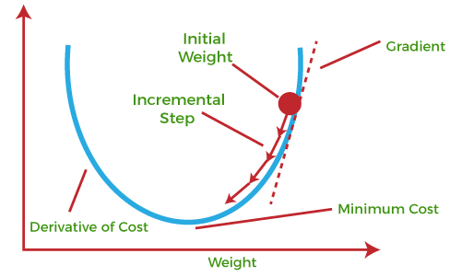
Gradient Descent
Gradient descent: A mathematical optimization algorithm that adjusts the parameters of a model to minimize the cost or loss function.
Stochastic gradient descent with exponential convergence: A variant of gradient descent that randomly selects mini-batches of training data and uses an adaptive learning rate to converge faster towards the minimum of the cost function.
Main advantage of stochastic gradient descent with exponential convergence: Handles large datasets with high dimensionality and non-convex loss functions more efficiently, resulting in faster convergence and better performance.

Slide 9
Proposed System Pipeline Design
Pipeline For Project Design Overview
Pipeline For Pre-Processing
Pipeline For De-Processing
Process Of Compute Loss And Gradients
Pipeline For Proposed System (Stylegen Application)

Slide 10
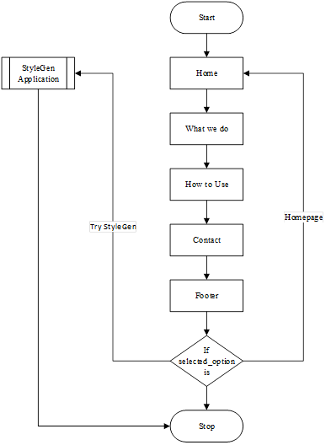
Pipeline For Project Design Overview

Slide 11
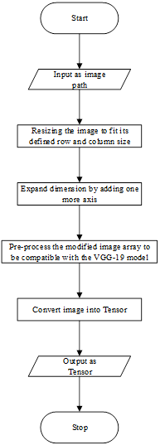
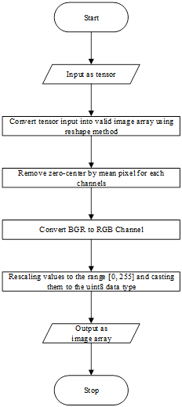
Pipeline For Pre-Processing
Pipeline For De-Processing

Slide 12
Calculate Loss and Gradients
1. Calculate Content Loss: Compute the content loss by comparing the feature representation of the target content image with the feature representation of the generated image.
Formula
ContentLoss = 0.5 * sum((F_target - F_generated)²)
Where, F_target and F_generated are the feature maps of the selected layer for the target content image and the generated image, respectively.
2. Calculate Style Loss: Compute the style loss by comparing the Gram matrices of the feature representations of the style image and the generated image at the selected layers.
Formula
StyleLoss = sum(w_l * sum((G_l_target - G_l_generated)²))
Where, G_l_target and G_l_generated are the Gram matrices of the feature maps of the selected layer for the style image and the generated image, respectively, and w_l is a weighting factor for the corresponding layer.

Slide 13
Calculate Gram Matrix
Given a feature map F of size C x H x W, where C is the number of channels and H, W are the height and width of the feature map respectively, the Gram matrix G of F is a C x C matrix defined as: G = F * F^{T} / (C * H * W) Where, * denotes matrix multiplication.

Slide 14
Calculate Loss and Gradients
3. Calculate Total Loss: Combine the content loss and the style loss to obtain the total loss.
Formula
TotalLoss = α * ContentLoss + β * StyleLoss
Where, α (alpha) and β (beta) are weighting factors for the content and style loss, respectively.
4. Compute Gradients: Compute the gradients of the total loss with respect to the pixel values of the generated image.
Formula
Gradients = d(TotalLoss) / d(GeneratedImage)
Where, GeneratedImage is the image being generated and the differentiation of TotalLoss with respect to GeneratedImage i.e., d(TotalLoss) / d(GeneratedImage) is the gradient of the total loss with respect to the pixel values of the generated image.

Slide 15
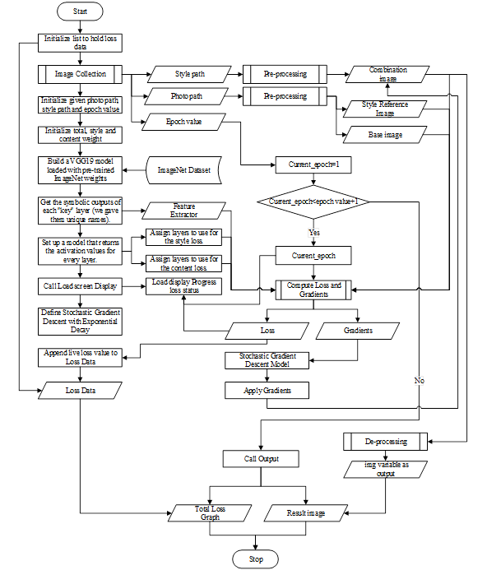
Pipeline For Proposed System (Stylegen Application)

Slide 16
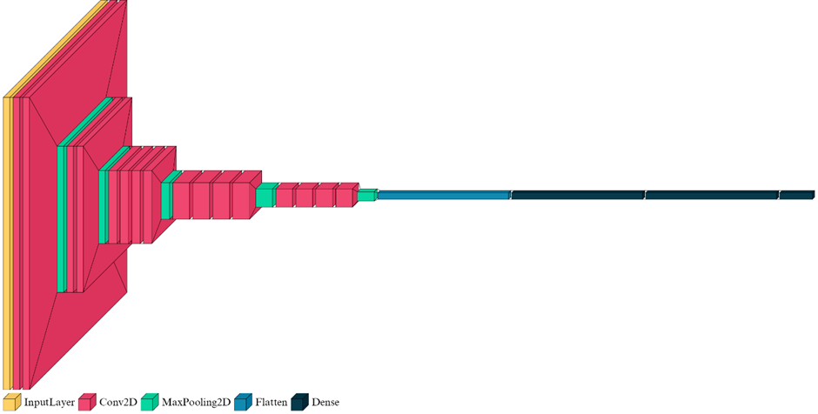
Architecture Design
VGG-19 Architecture

Slide 17
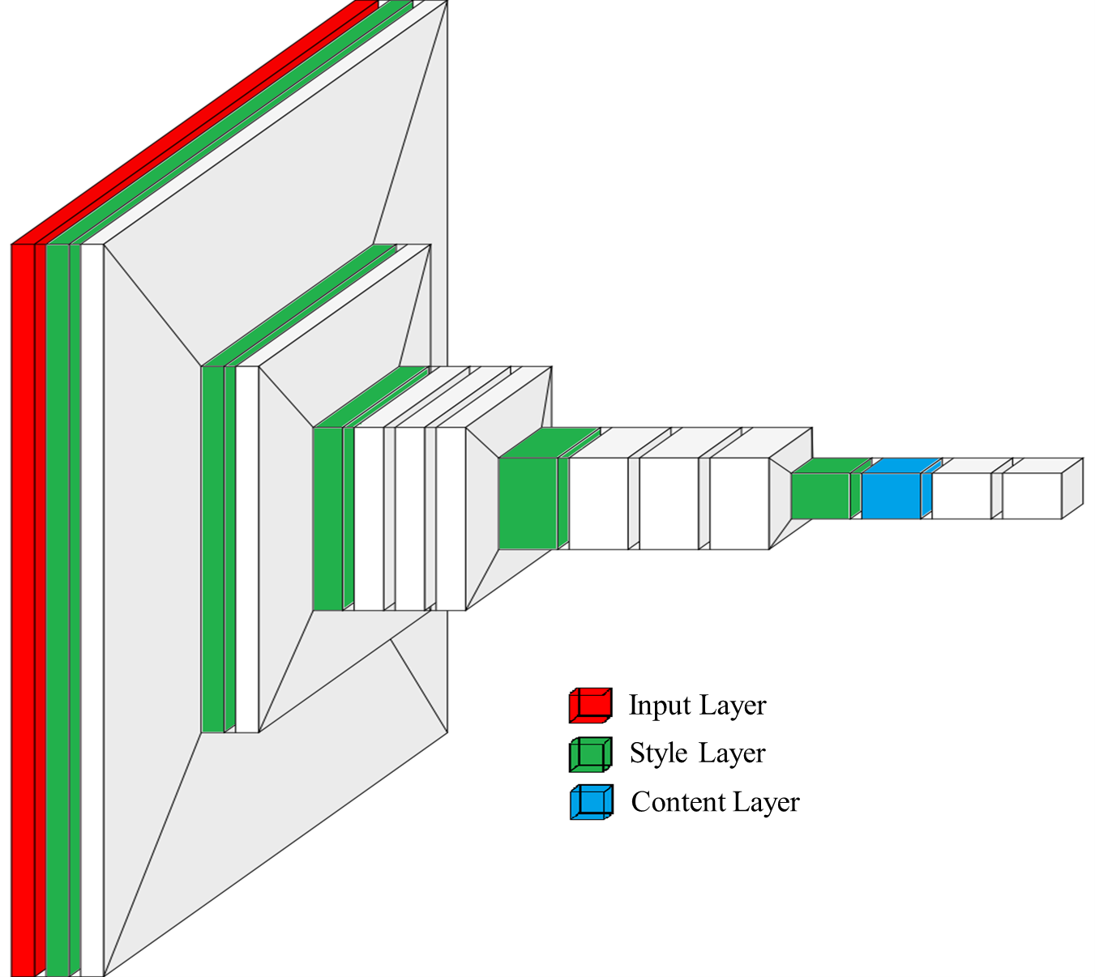
Architecture Design
VGG-19 Architecture Extracted as Style Layer and Content Layer

Slide 18
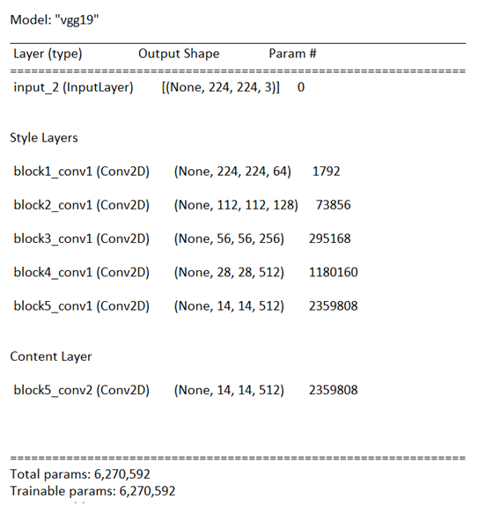
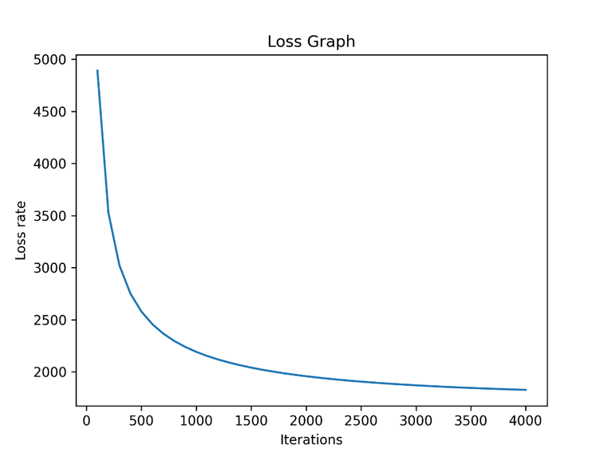
Architecture Design
Model Summary
Total Loss Graph

Slide 19
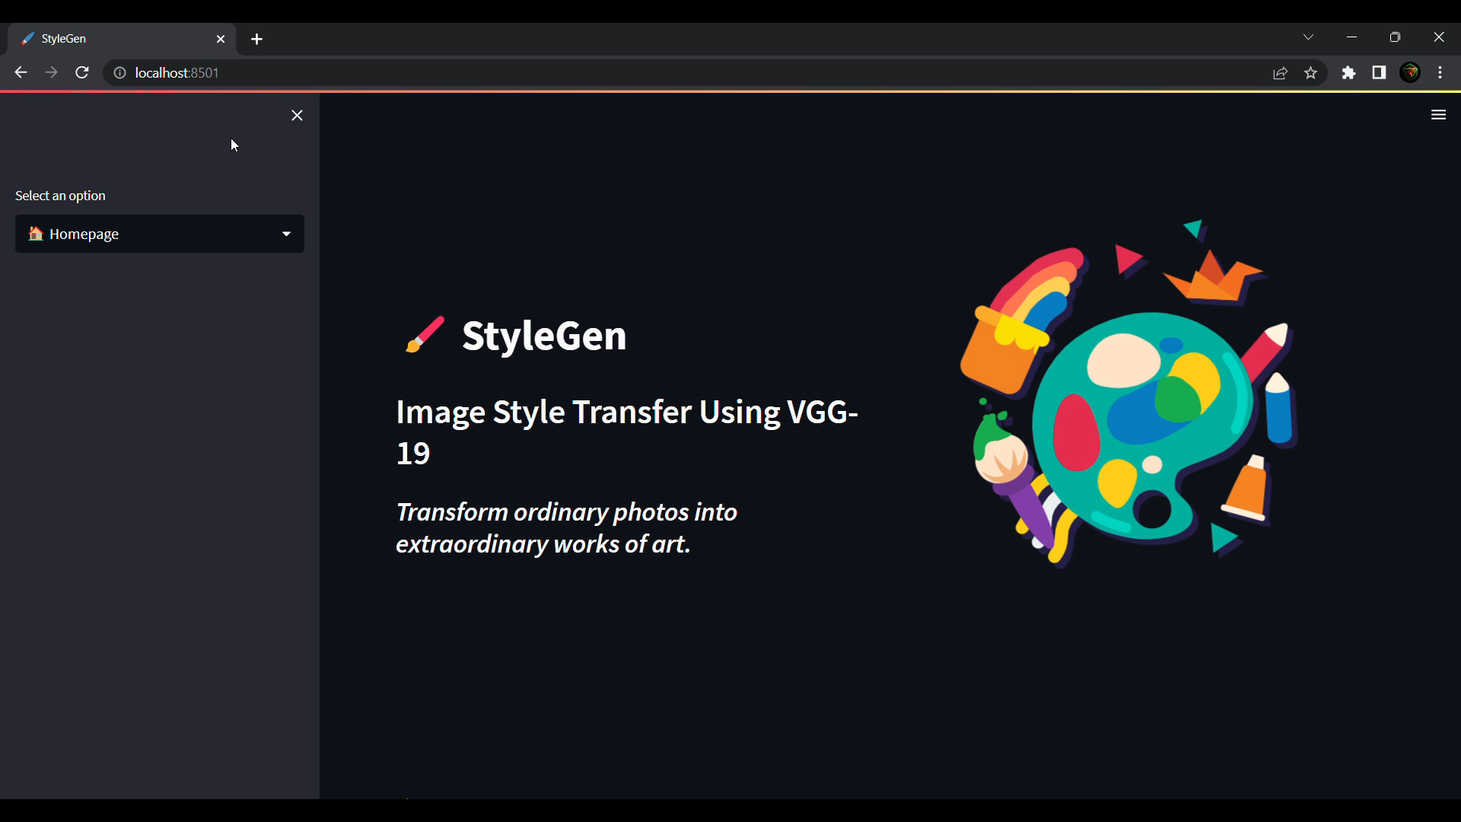
Screen Record

Slide 20
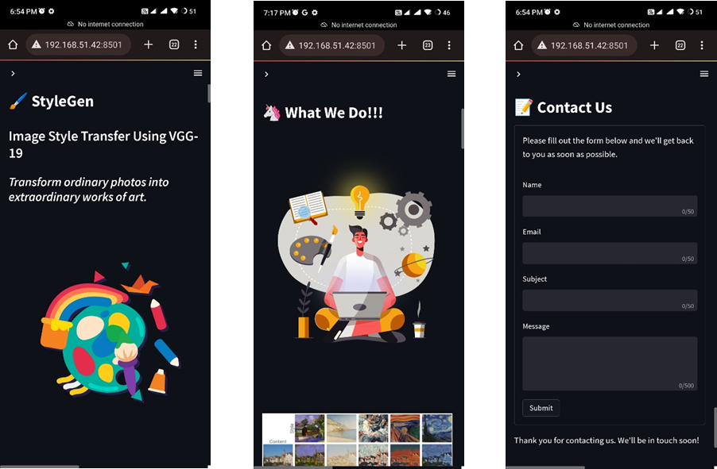
Screen Shots

Slide 21
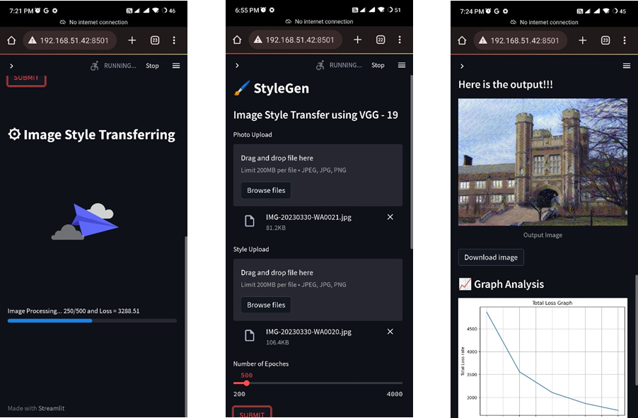
Screen Shots

Slide 22
Conclusion
The project has been completed as per the system requirements.
The implementation and testing has been done in a progressive manner.
During this duration of this project implementation. I learned the following things :
Python
Streamlit
Data Science and Machine Learning
Deep learning
TensorFlow
Keras

Slide 23
Future Enhancements
Integrating the StyleGen application with the DALL-E 2 architecture could unlock additional features.
Establishing a structured system with a hierarchy of personnel to oversee and provide necessary services could help maintain harmony within the system, rather than relying on a standalone system as it is now.
Implementing a profile system to track work history.
Developing an online community to foster and promote the growth of the application. This could be achieved by creating a website for our application to generate and implement new ideas, ensuring the system remains reliable and enduring.

Slide 24
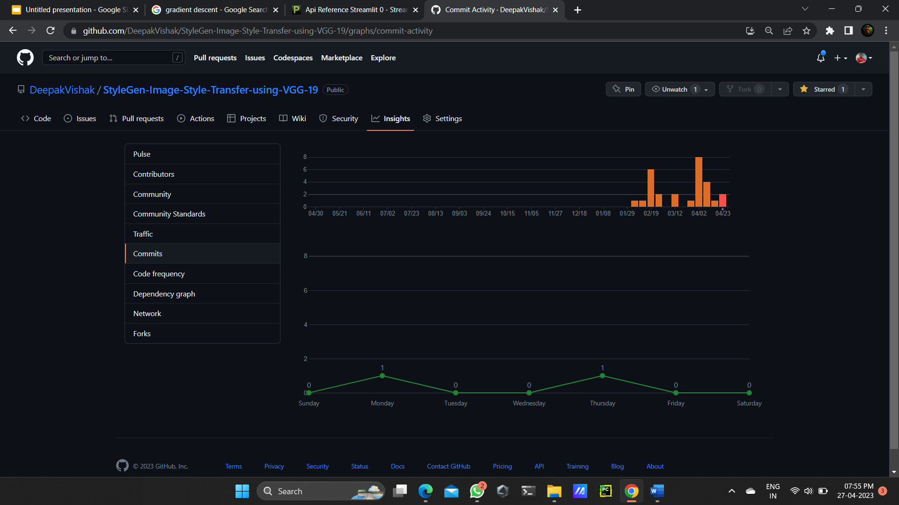
Git History

Slide 25
References
BOOKS
[1] Convolutional neural networks for visual computing (Chapter 4), Ragav Venkatesan and Baoxin Li CRC press
[2] Online book Dive Deep into Machine Learning at https://d2l.ai/
[3] E. Alpayidin, Introduction to Machine Learning, Prentice Hall of India (2005)
[4] Jeeva Jose, “Taming Python by Programming”, Khanna Publishers, New Delhi, 2018
WEBSITES
[5] https://www.tensorflow.org/
[6] https://docs.streamlit.io/
[7] https://keras.io/
JOURNAL AND PUBLICATIONS
[8] Image Style Transfer Based on VGG Neural Network Model;2022 IEEE International Conference on Advances in Electrical Engineering and Computer Applications (AEECA); IEEE; 20-21 August 2022; Dalian, China
https://ieeexplore.ieee.org/document/9918891
[9] Style Transfer with Generative Adversarial Networks; Seconda Sessione di Laurea Anno Accademico 2017 – 2018; Prof. Davide Maltoni, Gabriele Graffieti
[10] Zhang, Yuxin, et al. "Domain enhanced arbitrary image style transfer via contrastive learning." ACM SIGGRAPH 2022 Conference Proceedings. 2022.

Slide 26
THANK
YOU

